Slide 1
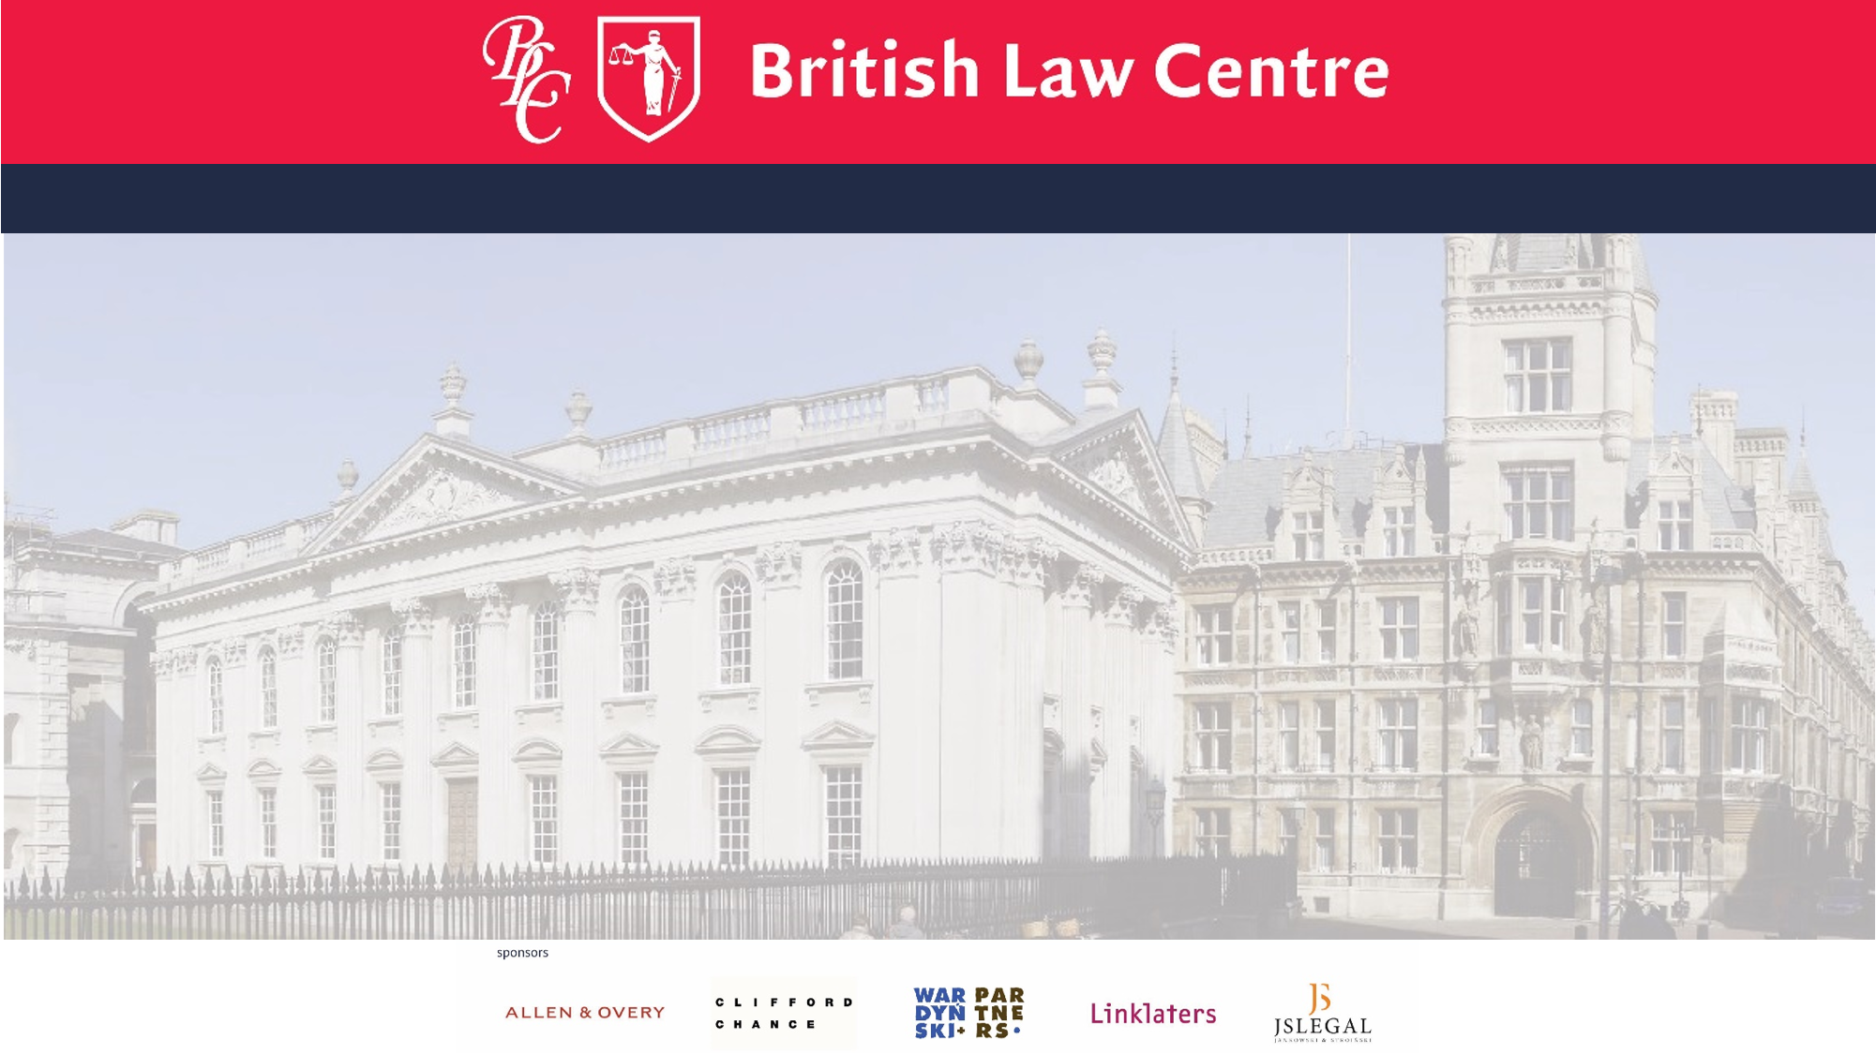

Are you fluent in English
but want to improve
your English legal language?
Do you want to find out more about the common law and how common lawyers think?
And how judges create law?
Interested in EU law and want to see the common law perspective?
Then you might like to come and study at the British Law Centre

Slide 2
The Certificate/Diploma in English and European Union law is open to all students, lawyers, linguists and graduates who have an interest in learning more of the common law system and English and European Union law
And
who wish to learn more of the legal skills central to the training of the English common lawyer.
A new BLC centre may open in Olszytn in 2016-2017, but a minimum number of students are required.

Slide 3
If you would like more information on this possiblity then mail us by 30th April
britishlawcentre.co.uk
Contact :
dariusz.gibasiewicz@uwm.edu.pl

